Slide 1


Introduction to Python
Framework Training

Slide 2
Plan for Session
Python Versions
Where is Python Used?
Common Python Libraries
Execution Model
Running Python Programs
Where to get Python
Useful Online Resources

Slide 3
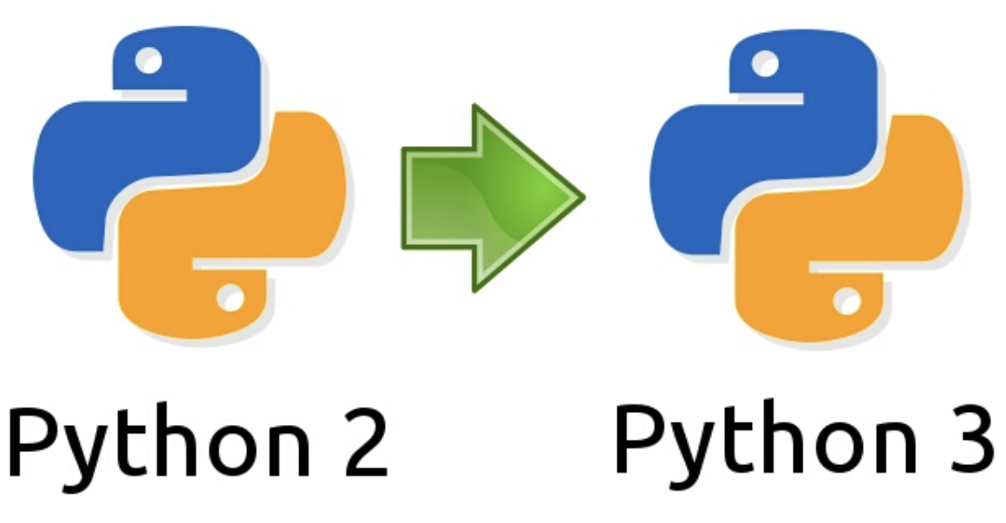
Python Versions
Originates in 1980s created by Guido van Rossum
Intended as a general-purpose programming language
Currently two main versions of Python in circulation
Python 2 and Python 3
Two versions are incompatible
Python 2
Python 3
Which version to use
Python 2 still used a bit but end of life as of Jan 1st, 2020
Python 3 currently supported version
print 'Hello World'
print('Hello World')

Slide 4
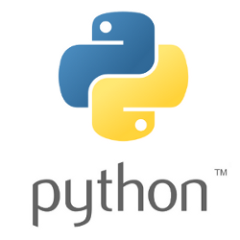
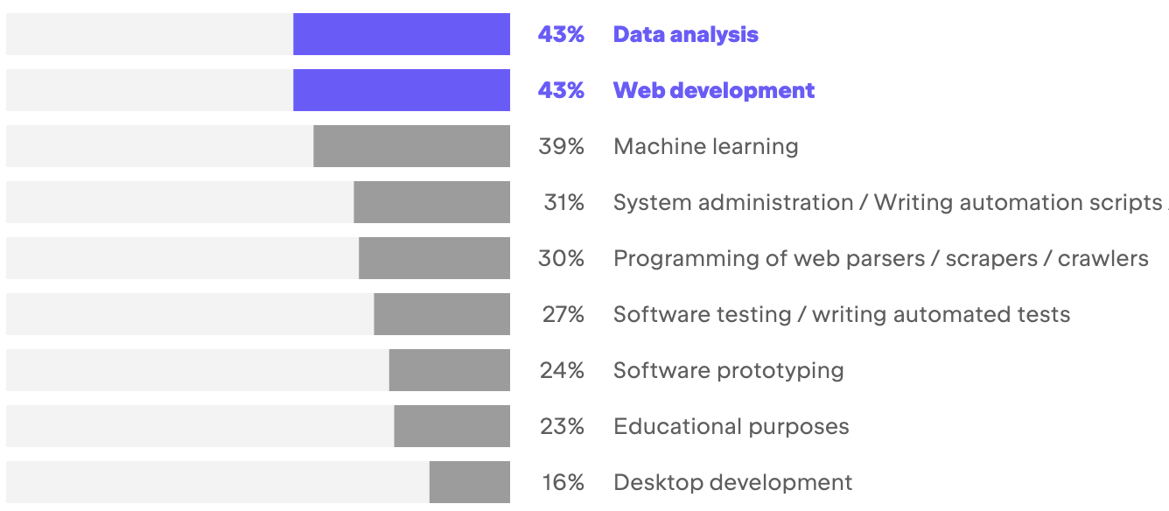
Where is Python Used?
Data Analysis & Web Development most common
Machine Learning catching up
https://www.jetbrains.com/lp/devecosystem-2022/python/

Slide 5
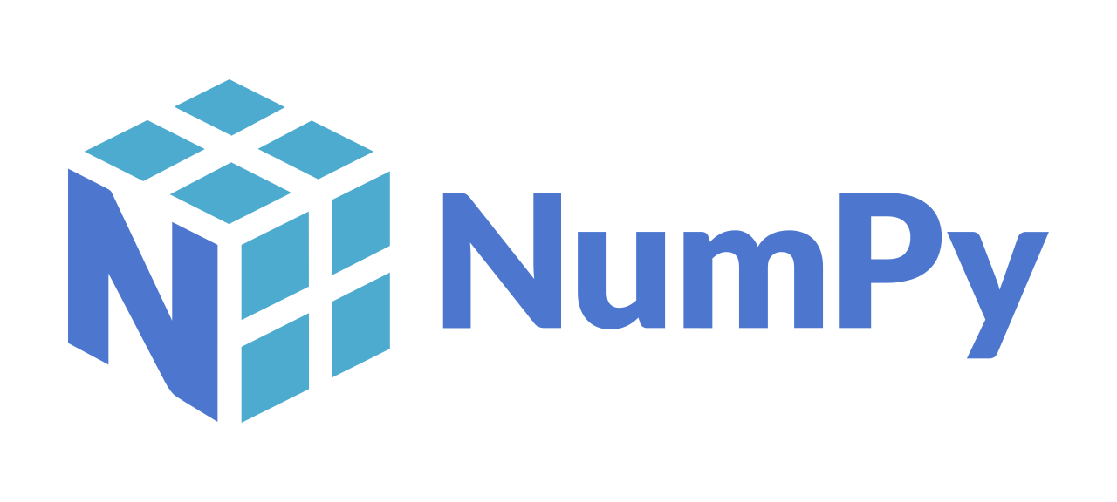

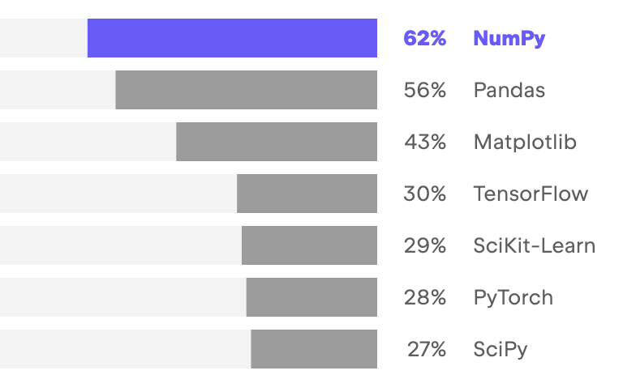
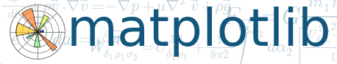

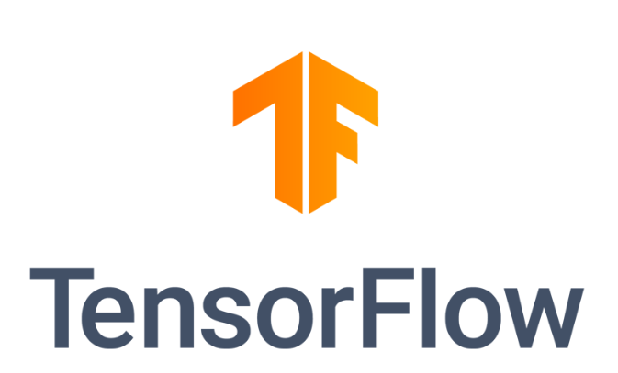
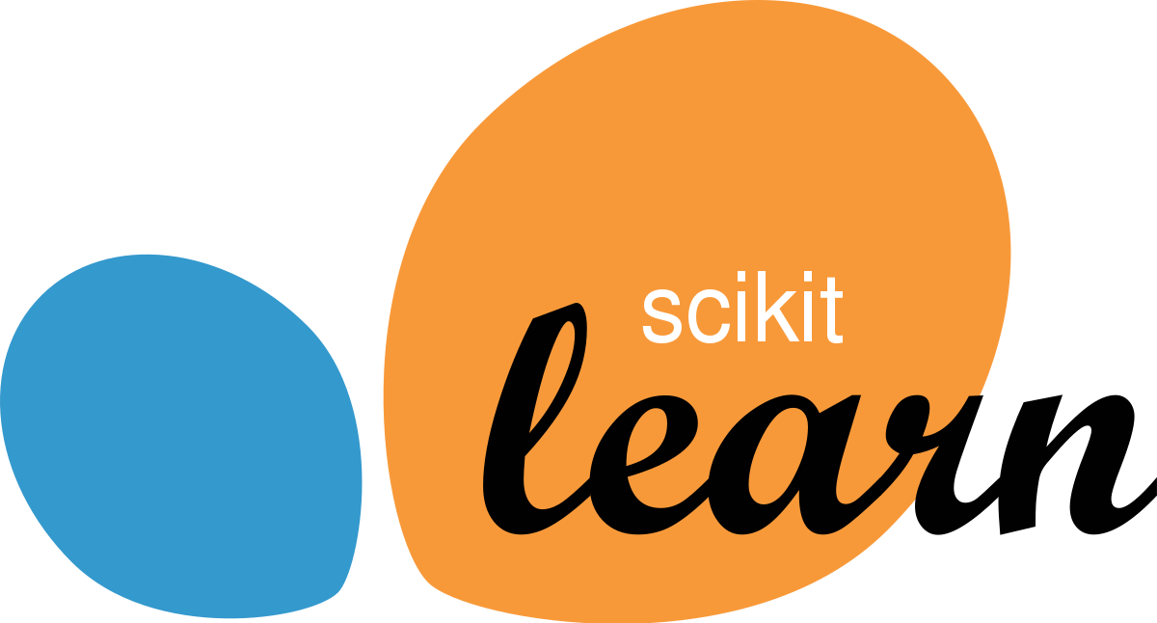
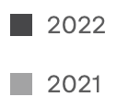
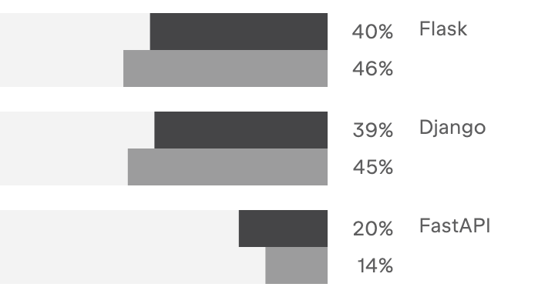


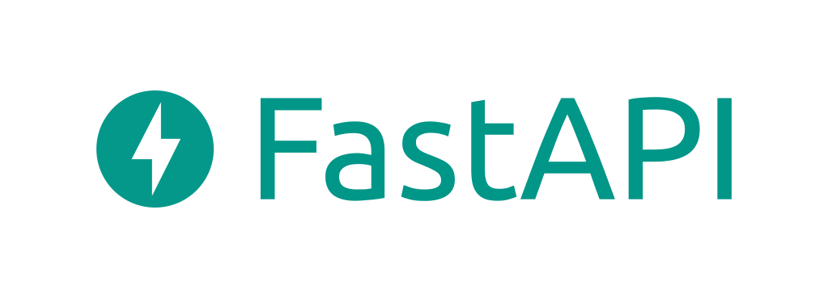
Common Python Libraries
https://www.jetbrains.com/lp/devecosystem-2022/python/
Data Science Libraries
Web Frameworks

Slide 6
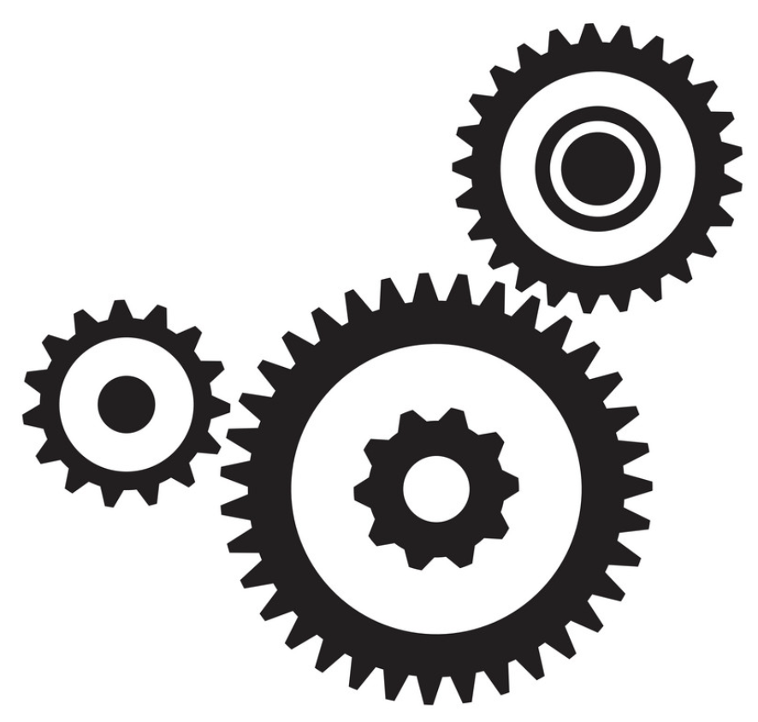
Python Execution Model
Not a precompiled language
But not exactly an interpreted language either
Simplified process illustrative of behaviour
Check the Program is valid and well formed
Python
hello.py
(Dynamically) Compile
Into the Intermediate language
Run the intermediate
version of the program
Notes:
The way in which the Python interpreter processes a Python program is broken down into several steps. The steps shown here are illustrative (and simplified) but the general idea is correct.
First the program is checked to make sure that it is valid Python, that is a check is made that the program follows all the rules of the language and that each of the commands and operations etc. is understood by the Python environment.
It then translates the plain text, English like commands, into a more concise intermediate format that is easier to execute on a computer. Python can store this intermediate version in a file which is named after the original file but with a ‘.pyc’ extension instead of a ‘.py’ extension (the ‘c’ in the extension indicates it contains the compiled version of the code).
The compiled intermediate version is then executed by the interpreter.

Slide 7
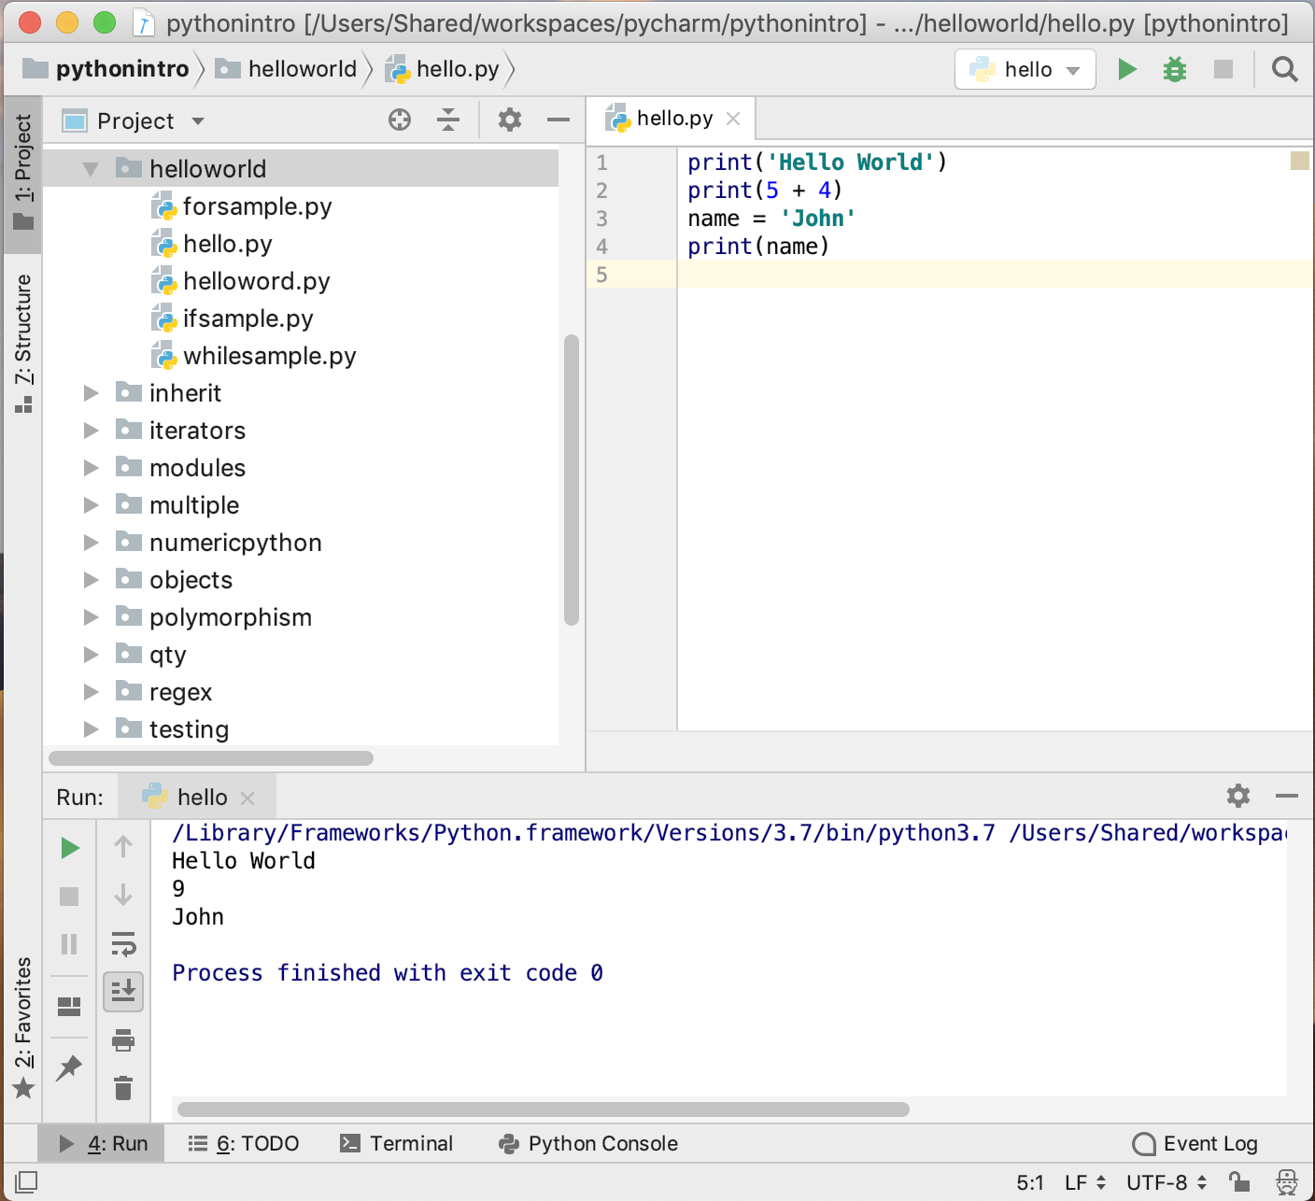
Python IDEs
Several Python IDEs available
PyCharm
both free version
and commercial
Visual Studio Code
Free IDE from Microsoft
Spyder
scientific dev apps
Eclipse + PyDev plugin
Jupyter Notebooks
target data analysis tasks

Slide 8
Useful Resources
Python Software Foundation
https://en.wikipedia.org/wiki/Python_Software_Foundation
The main Python 3 documentation site
https://docs.python.org/3/
List of all the builtin features
https://docs.python.org/3/library/index.html
Python 3 Module of the week site
https://pymotw.com/3
Python Resources
https://wiki.python.org/moin/BeginnersGuide/Programmers
W3 School Intro to Python
https://www.w3schools.com/python/

Slide 9
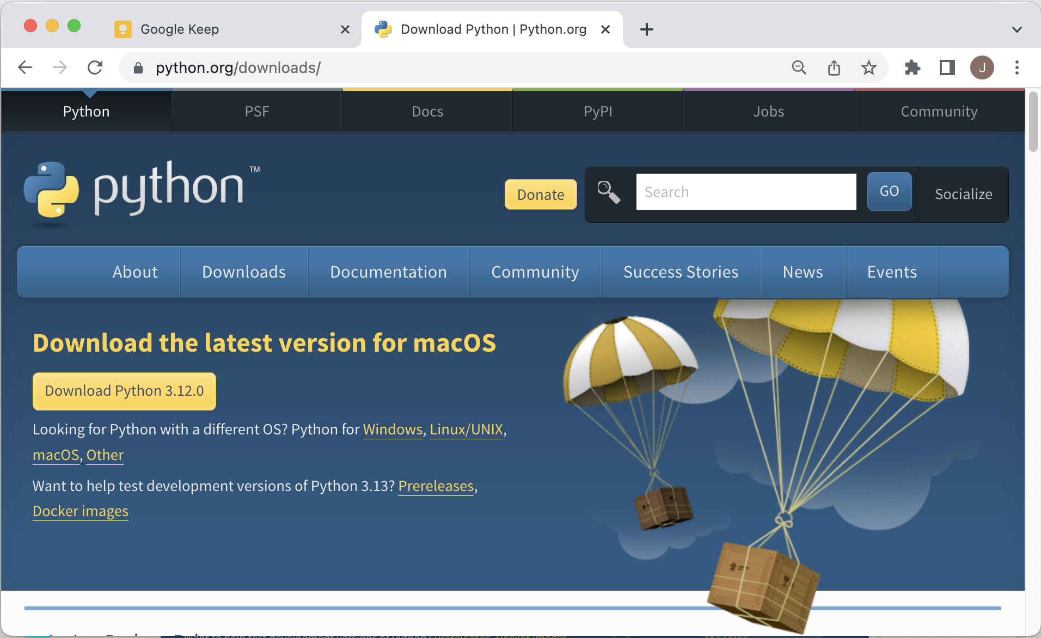
Where to get Python
https://www.python.org/downloads/

Slide 10
Questions?
?

